Slide 1
Part One: Introducing Management
Chapter Two: Traditional and Contemporary Issues and Callenges

Slide 2
Importance of Theory and History
Theory
A conceptual framework for organizing knowledge and providing a blueprint for action.

Slide 3
Importance of Theory and History
Management theories are grounded in reality.
Theories are used to build organizations and guide them toward their goals.
Understanding the historical context provides a sense of heritage and helps managers avoid mistakes of others.

Slide 4
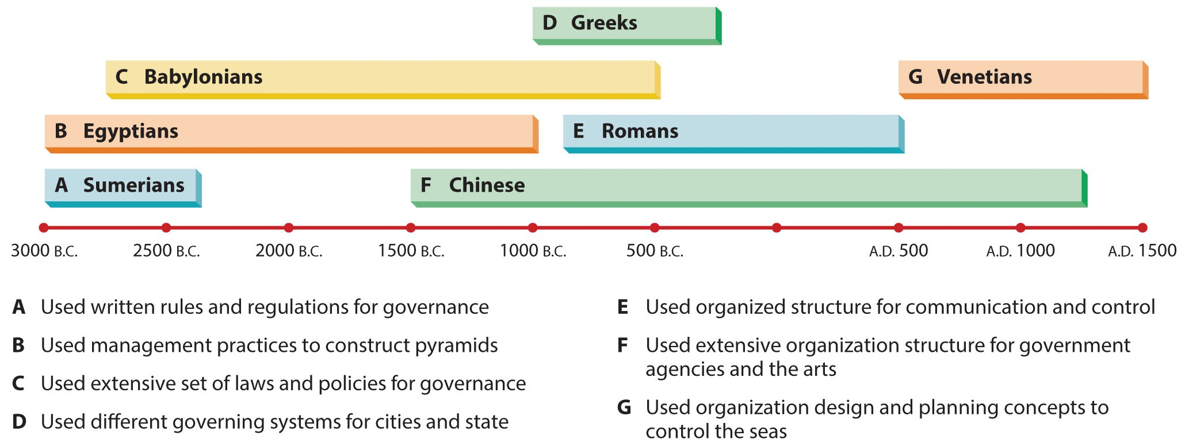
Figure 2.1
Management in Antiquity
This simple time line shows a few of the most important management breakthroughs and practices over the last 4,000 years.

Slide 5
Early Management Pioneers
Robert Owen
One of the first managers to recognize the importance of human resources.
He raised working age for children, reduced hours, and supplied meals.
Charles Babbage
Mathematically focused on efficiency of production.
Believed in division of labor.

Slide 6
Classical Management Perspective
Classical Management Perspective
Scientific Management
Administrative Management
Consists of two branches – scientific management and administrative management.
Focuses on ways to improve the production of individual workers.
Focuses on managing the total organization.

Slide 7
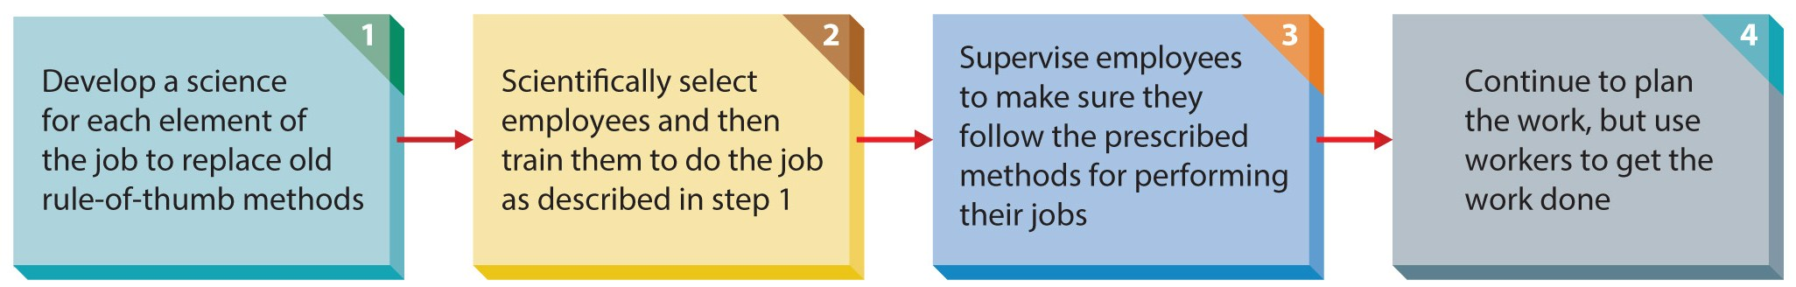
Figure 2.2
Steps in Scientific Management
Frederick Taylor saw workers soldiering, or deliberately working below their potential. He devised this four step method to overcome the problem.

Slide 8
Scientific Management
Frank and Lillian Gilbreth
They developed numerous techniques and strategies for eliminating inefficiency.
Henry Gantt
Introduced the Gantt chart for scheduling work.
Harrington Emerson
An advocate for specialized management roles.

Slide 9
Administrative Management
Henri Fayol
First to identify the four management functions.
Lyndall Urwick
Integrated scientific and administrative management.
Max Weber
Studied efficient organizational structure.
Chester Barnard
Wrote about acceptance of authority.

Slide 10
Classical Management Today
Contributions
Laid the foundation for management theory.
Identified key processes, functions, and skills.
Made management a valid subject of study.
Limitations
Best used in simple, stable organizations.
Universal procedures may not be appropriate in some settings.
Employees not viewed as resources.

Slide 11
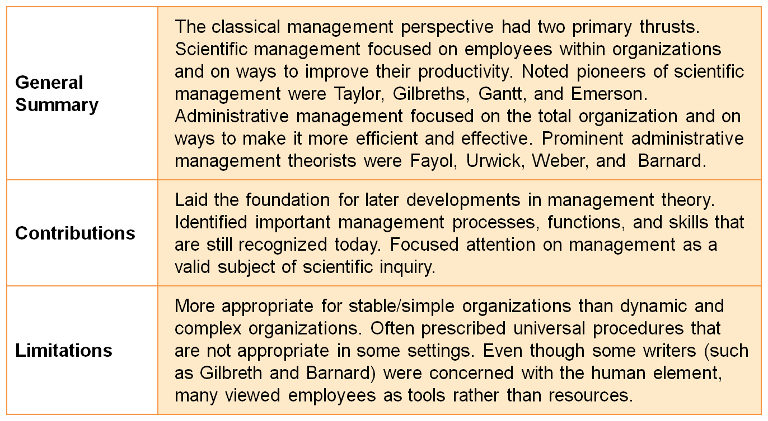
Table 2.1
Classical Management Perspective

Slide 12
Behavioral Management Perspective
Behavioral management perspective
Emphasizes individual attitudes and behaviors and group processes.
Hugo Munsterberg applied psychology to the industrial setting, founding the field of industrial psychology.
Mary Parker Follett was an early pioneer of this theory.

Slide 13
Behavioral Management Perspective
Conducted the Hawthorne Studies
Found increased productivity in both control and experimental group.
Later attributed to heightened employee morale due to extra attention.
Later studies identified:
“rate busters” (overproducers) and “chiselers” (underproducers).
Their conclusion:
Human behavior was much more important in the workplace than previously believed.

Slide 14
Human Relations Movement
Human relations movement
Argued that workers respond primarily to the social context of the workplace.
Stemmed from the Hawthorne studies.
A basic assumption is that a manager’s concern for workers will lead to increased satisfaction and improved performance.

Slide 15
Human Relations Movement
Theory X
A pessimistic and negative view of workers consistent with the views of scientific management.
Theory Y
A positive view of workers; it represents the assumptions that human relations advocates make.
Includes Maslow’s Hierarchy of Needs and Douglas McGregor’s Theory X and Theory Y.

Slide 16
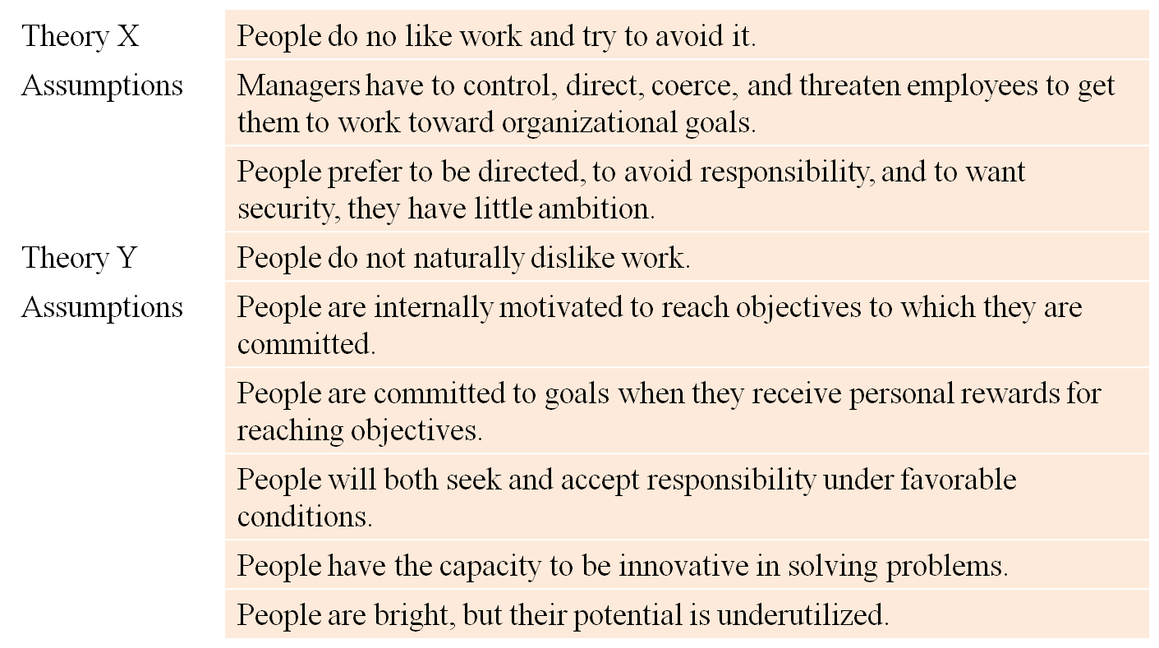
Theory X and Theory Y
Source: D. McGregor and W. Bennis, The Human Side Enterprise: 25th Anniversary Printing, 1985.

Slide 17
Emergence of Organizational Behavior
Organizational behavior
Contemporary field focusing on behavioral perspectives on management.
Organizational behavior takes a holistic view of behavior and addresses individual, group, and organization processes.

Slide 18
Behavioral Management Today
Contributions
Gave insights into interpersonal processes.
Such as motivation and group dynamics.
Focused managerial attention on these processes.
Viewed employees as resources.
Limitations
Behavior is difficult to predict.
Managers are reluctant to adopt concepts.
Research ineffectively communicated to managers.

Slide 19
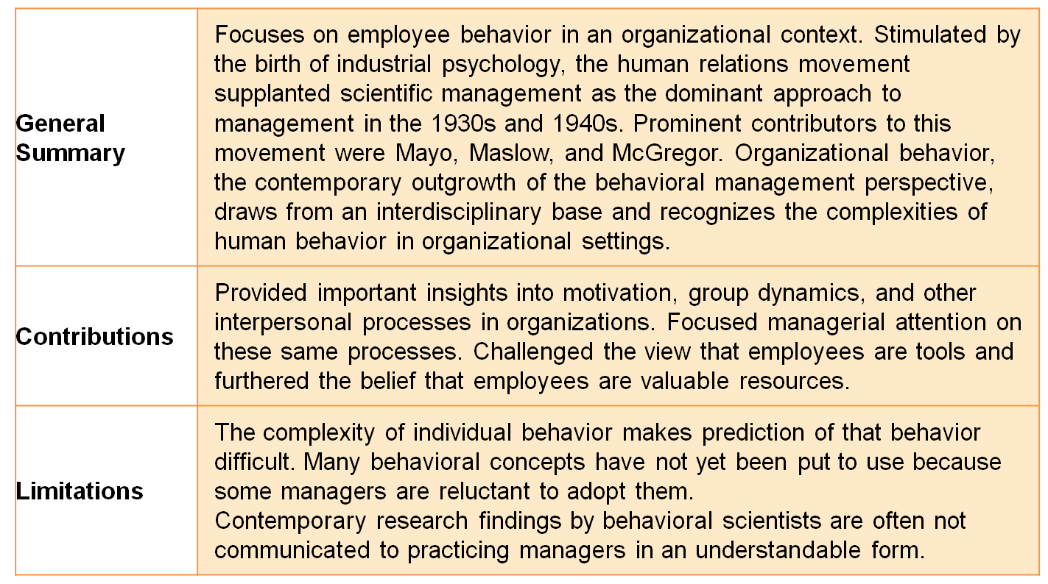
Table 2.3
Behavioral Management Perspective

Slide 20
Quantitative Management Perspective
Quantitative management perspective
Management science
Operations management
Applies quantitative techniques to management.
Focuses on decision-making, economic effectiveness, mathematical models, and the use of computers.
Concerned with helping the organization more efficiently produce its products or services.
Focuses specifically on the development of mathematical models.

Slide 21
Quantitative Management Today
Contributions
Sophisticated techniques assist decision-making.
Particularly useful in planning and controlling.
Increased awareness of complex processes.
Limitations
Cannot fully explain or predict behavior.
Mathematical sophistication may come at the expense of other important skills.
Models may require unrealistic assumptions.

Slide 22
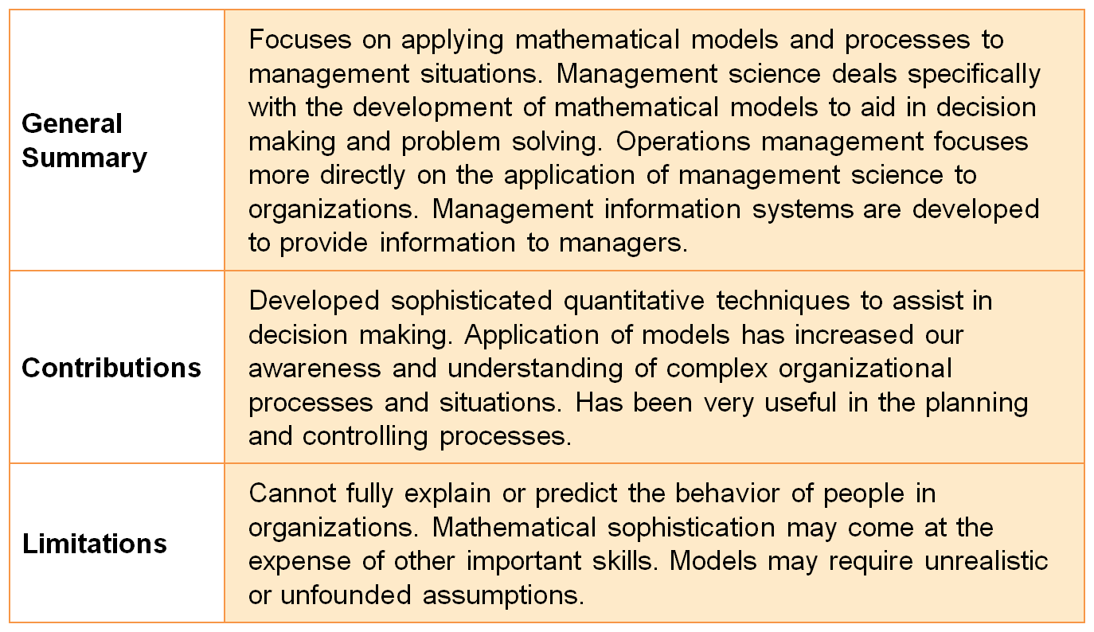
Table 2.4
Quantitative Management Perspective

Slide 23
Integrating Perspectives for Managers
Systems Perspective
A system is an interrelated set of elements functioning as a whole.
An open system is one that interacts with its environment.
A closed system does not interact with its environment.
A subsystem is a system within another system.

Slide 24
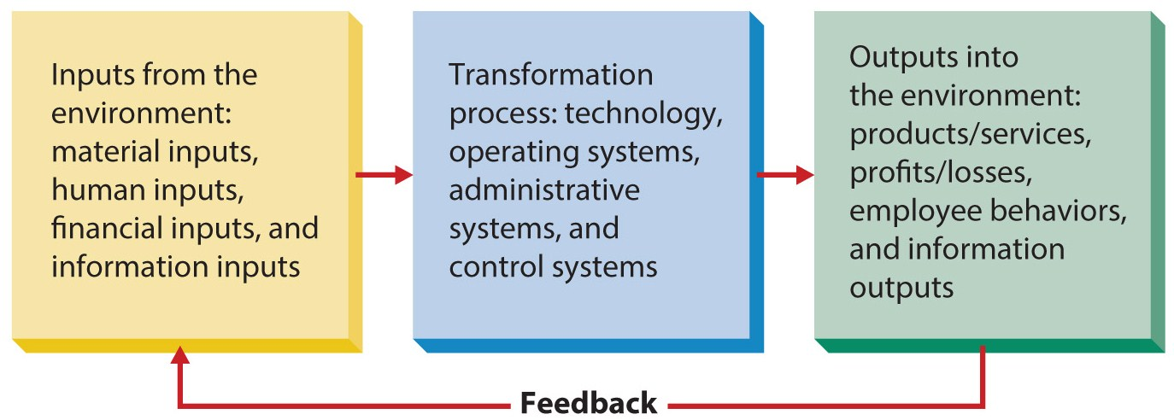
Figure 2.3
Systems Perspective of Organizations
Synergy is two or more subsystems working together to produce more than the total of what they might produce working alone.
Entropy is a normal process leading to system decline.

Slide 25
Contingency Perspective
A universal perspective tries to identify the “one best way” to do something.
Includes the classical, behavioral, and quantitative approaches.
The contingency perspective suggests that appropriate managerial behavior in a given situation depends on, or is contingent on, a wide variety of elements.
Believes each organization is unique.

Slide 26
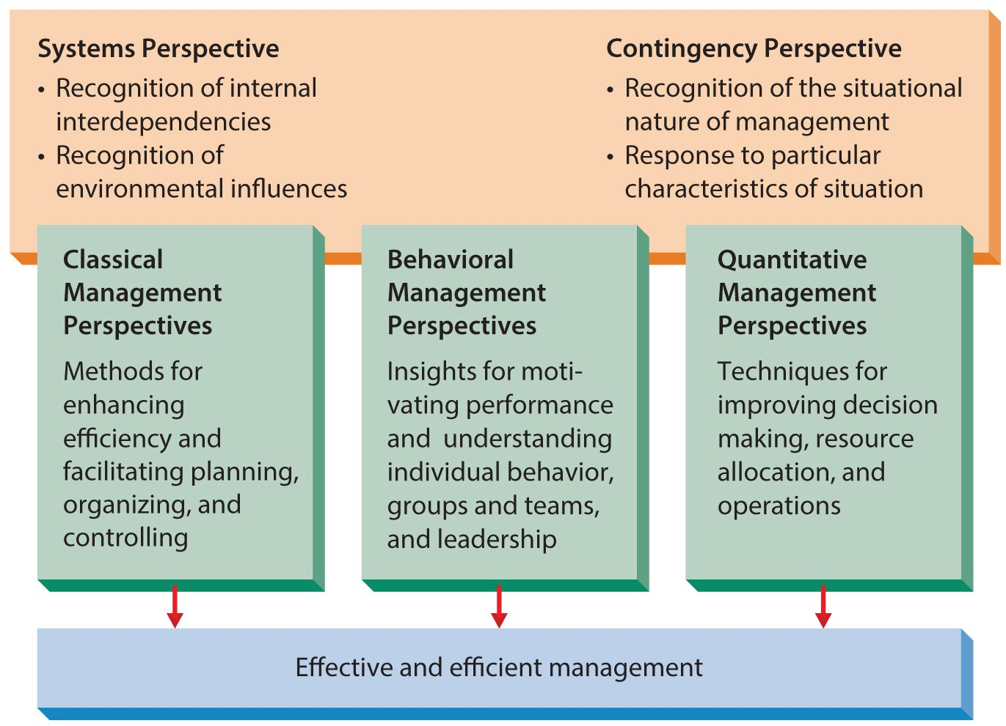
Figure 2.4
An Integrating Framework of Management Perspectives
Managers should include portions of each perspective relevant to their situation and apply them using systems and contingency approaches.

Slide 27
Contemporary Applied Perspectives
Major impacts include:
Theory Z
In Search of Excellence
Biographies of successful business leaders.
Authors such as Peter Senge, Stephen Covey, Tom Peters, Michael Porter, John Kotter, and Gary Hamel.
Malcolm Gladwell’s books.
Even Dilbert cartoons had an impact.

Slide 28
Contemporary Management Challenges
An unpredictable economy, limiting growth.
Globalization presents many challenges.
Ethics and social responsibility in relation to corporate governance.
Quality as the basis for competition, increased productivity, and lower costs.
The shift toward a service economy.
The role and impact of social media.

